Slide 1
Team 14 Data Analytics 2022 Estimator Project
Kijahre Fikiri
Nancy Fujikado
Sarah-Michelle Sanchez
Alexei Mendoza

Slide 2
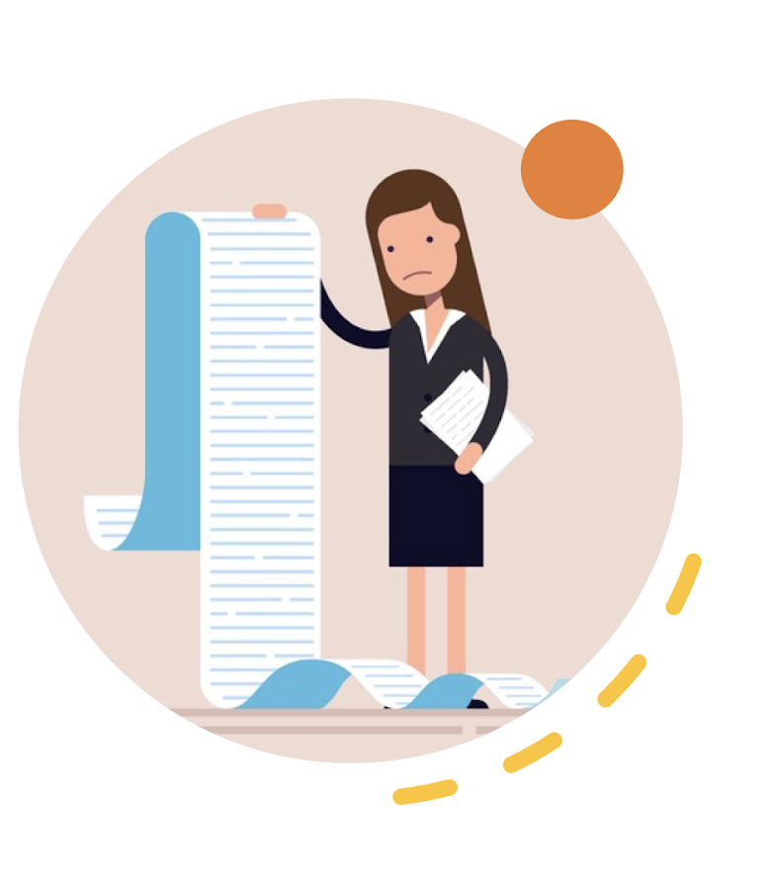
Topic: Expediting and forecasting price of electrical materials
The supply chain industry utilizes a "hot sheet" (a list of materials and their prices generated once a quarter) to price their materials.
Rise of inflation, ”hot sheets” need to be generated the day the estimate is created.
Increase in pricing frequency leads to excessive hours spent scouring the net searching for current material prices.

Slide 3
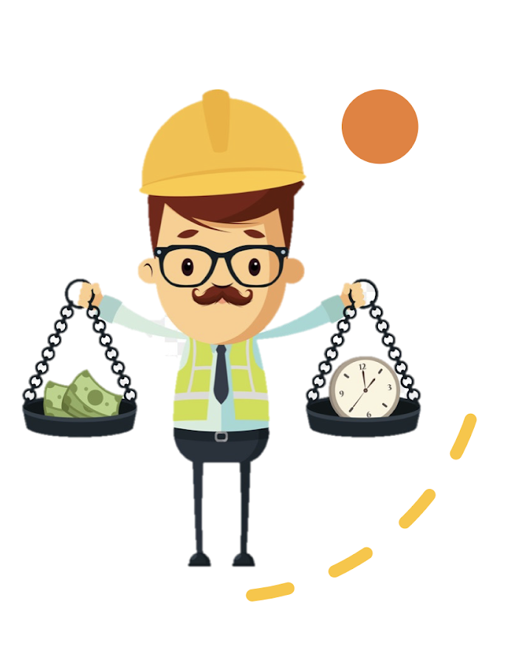
Goal: Save on time and money by creating an automated and predictive system
Live HTML/website powered by APIs to search prices of electrical material suppliers.
Generate a website that is updated daily with current material prices
Algorithm will choose the cheapest priced items of the day to populate the table.
ML to predict price fluctuation to determine when material costs increase or decrease.

Slide 4

Questions of Interest
Is there a correlation between the cost of conduit and fittings?
Is there a correlation between the cost of cable and the wires they require?
Is there a correlation between the cost of materials and the days of the week
Increase/decrease in material cost per day and if so can we predict the day?
Is there a relationship between a vendor’s location or region and how much they charge?
Is there a relationship between the size of the company and the discount it charges?

Slide 5
Database Integration
f

Slide 6
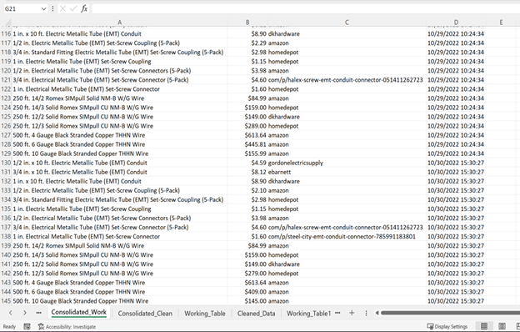
Data is sourced from our own data collection which began at project conception
During the beginning stages of the project, data has been collected for materials, pricing, and vendors.
This data will meet the 1000 line minimum needed for machine learning purposes.
As of 11/11/2022 we have >1000 lines of data.

Slide 7

Data Exploration Process
API approach was the alternative to web scraping
Collected data still requires a lot of cleaning.
Scaling and naming issues (different manufacturers have slightly different names for the same items).
Once the vendor columns were created, the vendor names are plugged into a slightly different Google shopping API that returns addresses.
A region column is created based off the address column.
Formatted datetime column and a synthetic column based on the datetime that provides the day of the week.
Since October 20th, data has been collected and consolidated data. The set has over 1000 rows of cleaned data with several features
(prices, location, region, day of the week) and targets (high prices, low prices, and about average prices).

Slide 8

ML model will be a logistic regression model
The ML model will utilize two-sampled T-tests to determine: model (In progress) that will establish:
The correlation between cable and wire prices
The correlation between conduit and fittings prices
The goal is to create a model that can predict which day of the week offers lowest price based on prices, vendor and location.
We will be using an unsupervised machine learning model that will sub-categorize the data by material item.
Estimator Project

Slide 9
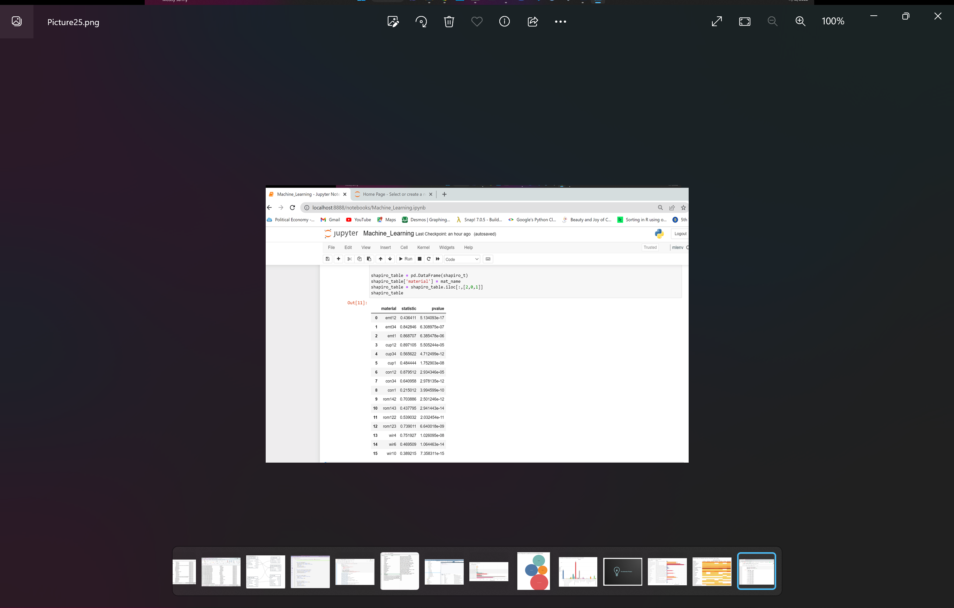
Data Analysis & Preliminary Data Processing
Conducted a Shapiro-Wilk test to determine if material prices are normally distributed.
All p-values are less than .05 which means that the material price data is not normally distributed

Slide 10
Data Analysis & Preliminary Data Processing
Conducted a Shapiro-Wilk test to determine if material prices are normally distributed.
All p-values are less than .05 which means that the material price data is not normally distributed

Slide 11
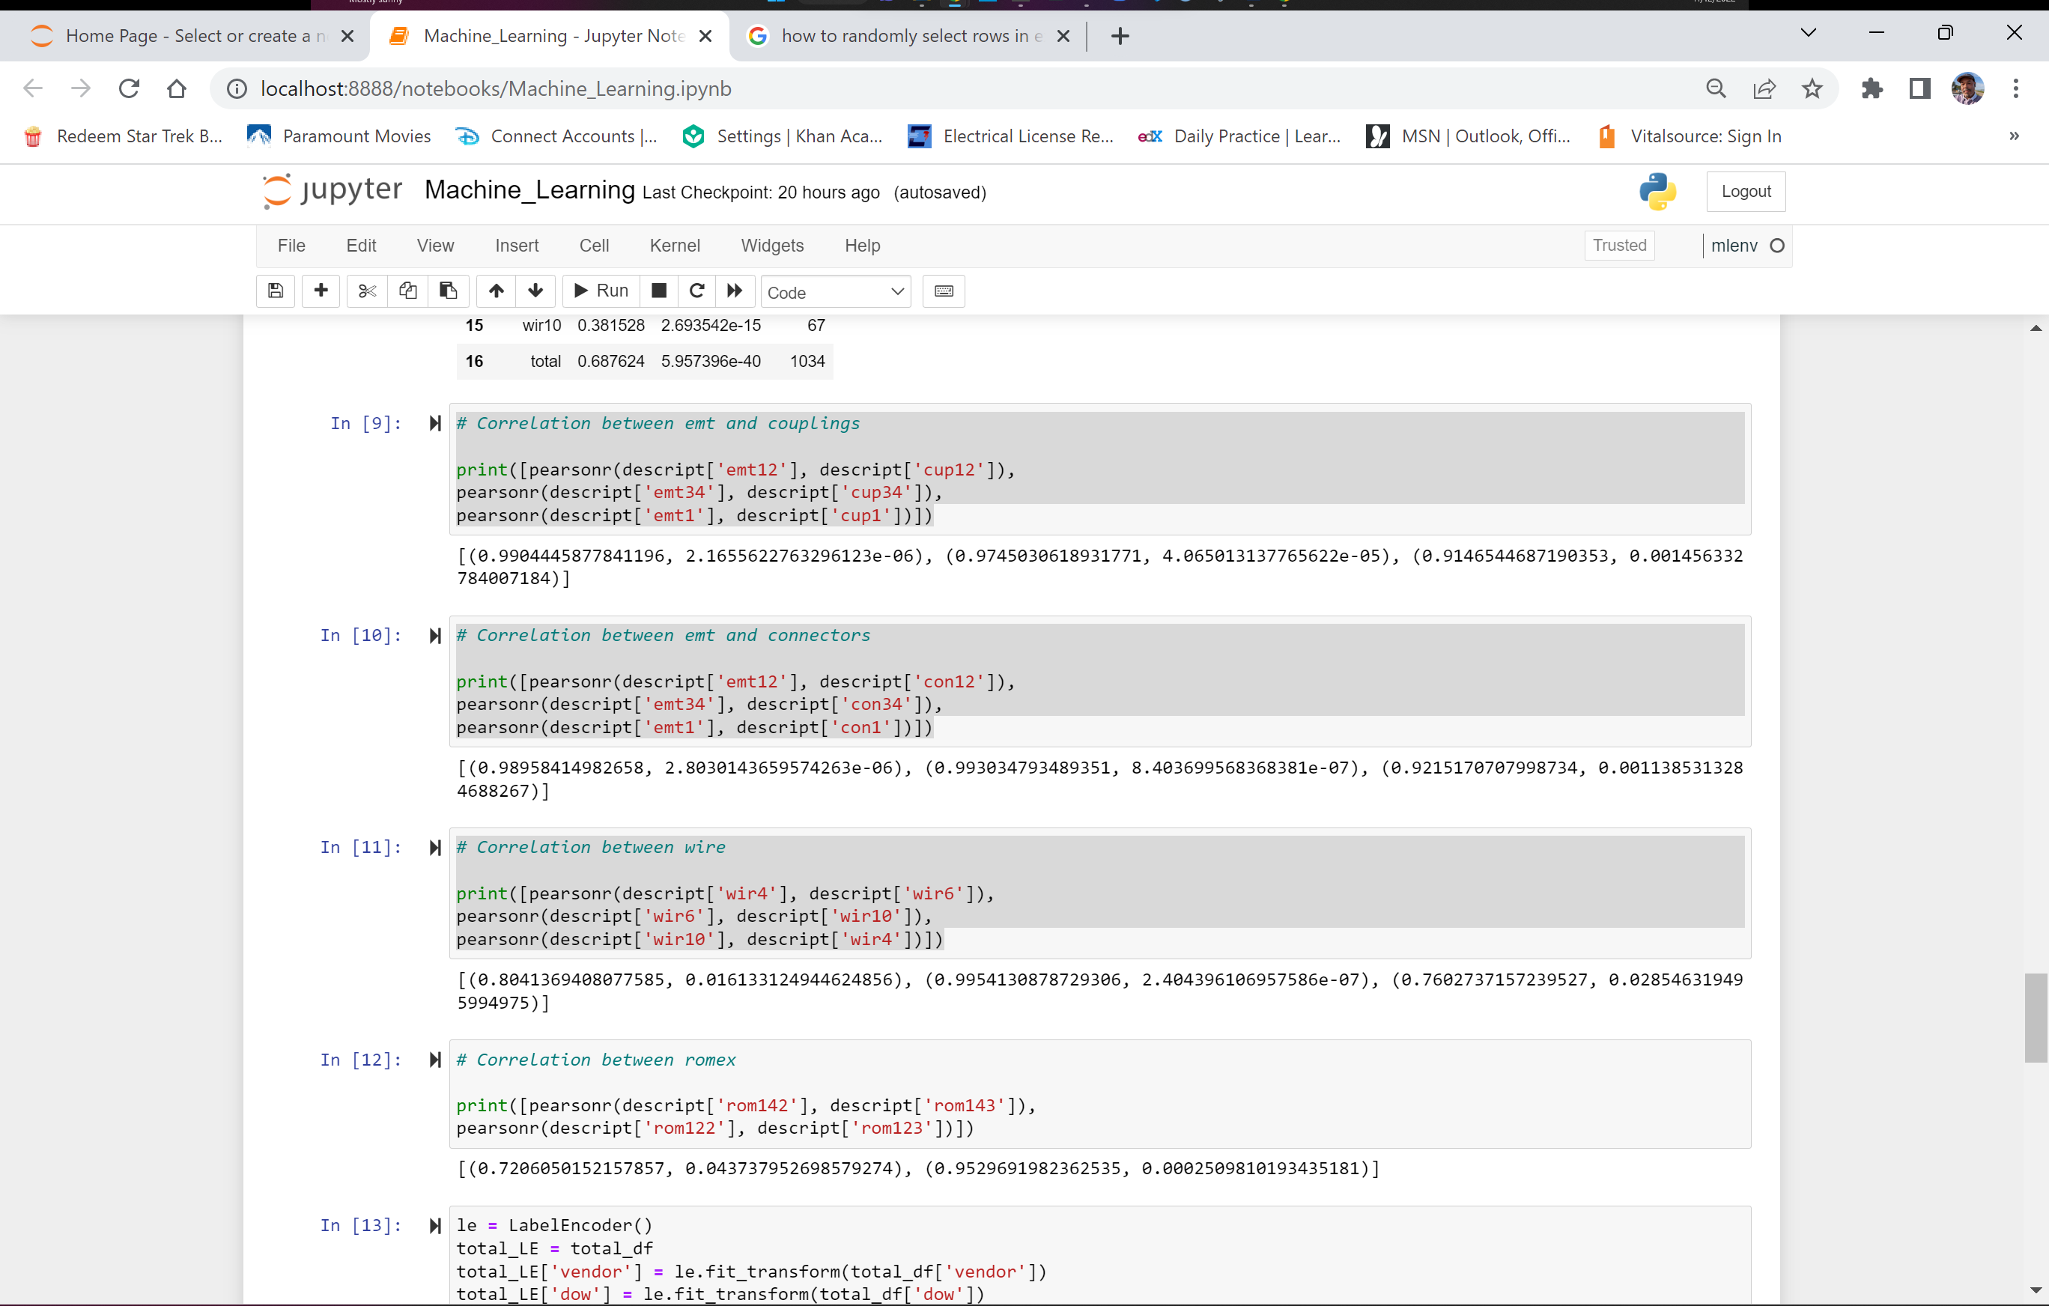
Data Analysis & Preliminary Data Processing
Checked to see if there was a correlation between:
Conduit and coupling (fitting)
Conduit and connector (fitting)
#4 wire and #6 wire
#6 wire and #10 wire
#10 wire and # 4 wire
Close correlation between #10 wire and # 4 wire and 1” conduit to 1” fittings.
However, none of the items were greater than the 0.05 p-value needed to establish correlation
Linked correlation between price of finished materials and raw materials needed to make them (copper to wire and steel to conduit)

Slide 12
Data Analysis & Preliminary Data Processing
Checked to see if there was a correlation between:
Conduit and coupling (fitting)
Conduit and connector (fitting)
#4 wire and #6 wire
#6 wire and #10 wire
#10 wire and # 4 wire
Close correlation between #10 wire and # 4 wire and 1” conduit to 1” fittings.
However, none of the items were greater than the 0.05 p-value needed to establish correlation
Linked correlation between price of finished materials and raw materials needed to make them (copper to wire and steel to conduit)

Slide 13
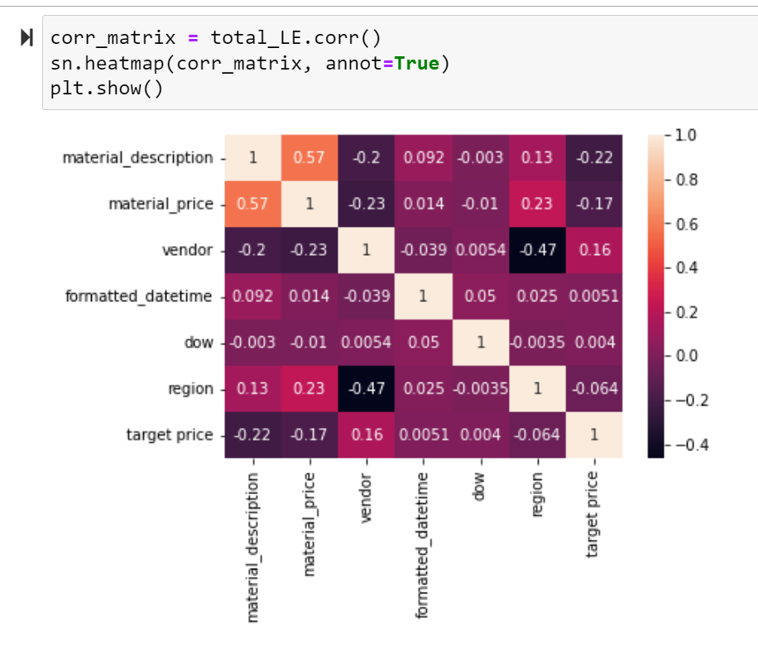
Data Analysis & Preliminary Data Processing
Ran a correlation matrix
Kept the price column and label encoded: material description, vendor, date , day of week, region, and target price to create a new data frame
The matrix shows some correlations with p values greater than 0.05

Slide 14
Data Analysis & Preliminary Data Processing
Ran a correlation matrix
Kept the price column and label encoded: material description, vendor, date , day of week, region, and target price to create a new data frame
The matrix shows some correlations with p values greater than 0.05

Slide 15
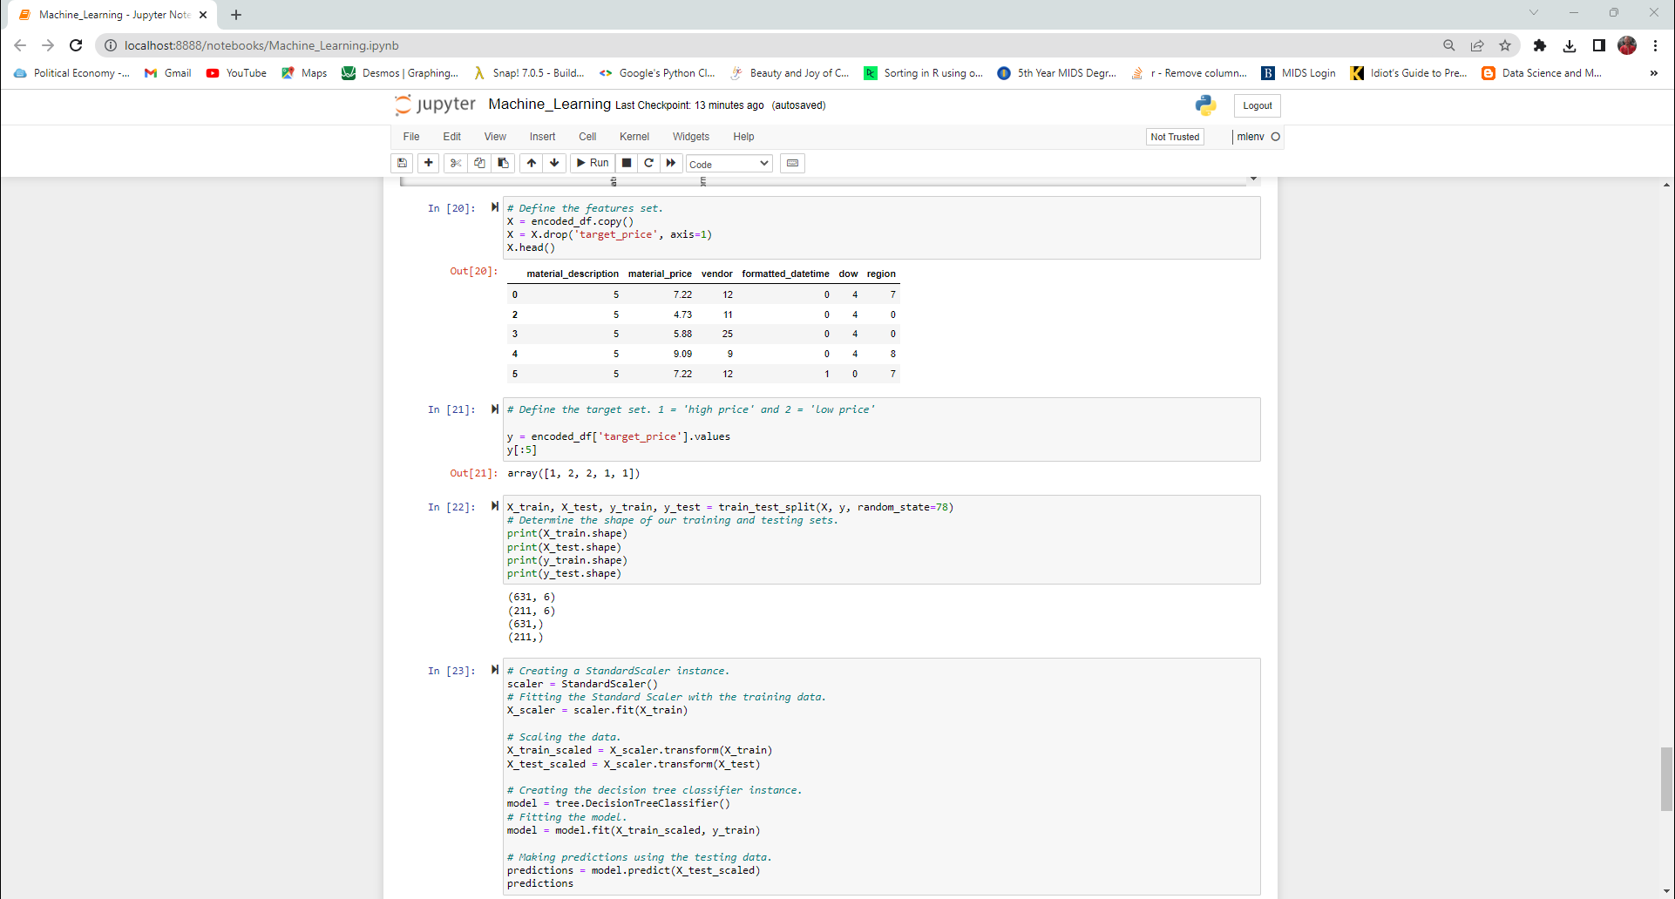
Data Analysis & Preliminary Feature Engineering
Within encoded data define a target of either “low price” or “high price”.
Separate data into features (X) and target (y).
Split the data into test and train.
Training data = 75% and Test data = 25%, scaled data.

Slide 16
Data Analysis & Preliminary Feature Engineering
Within encoded data define a target of either “low price” or “high price”.
Separate data into features (X) and target (y).
Split the data into test and train.
Training data = 75% and Test data = 25%, scaled data.

Slide 17
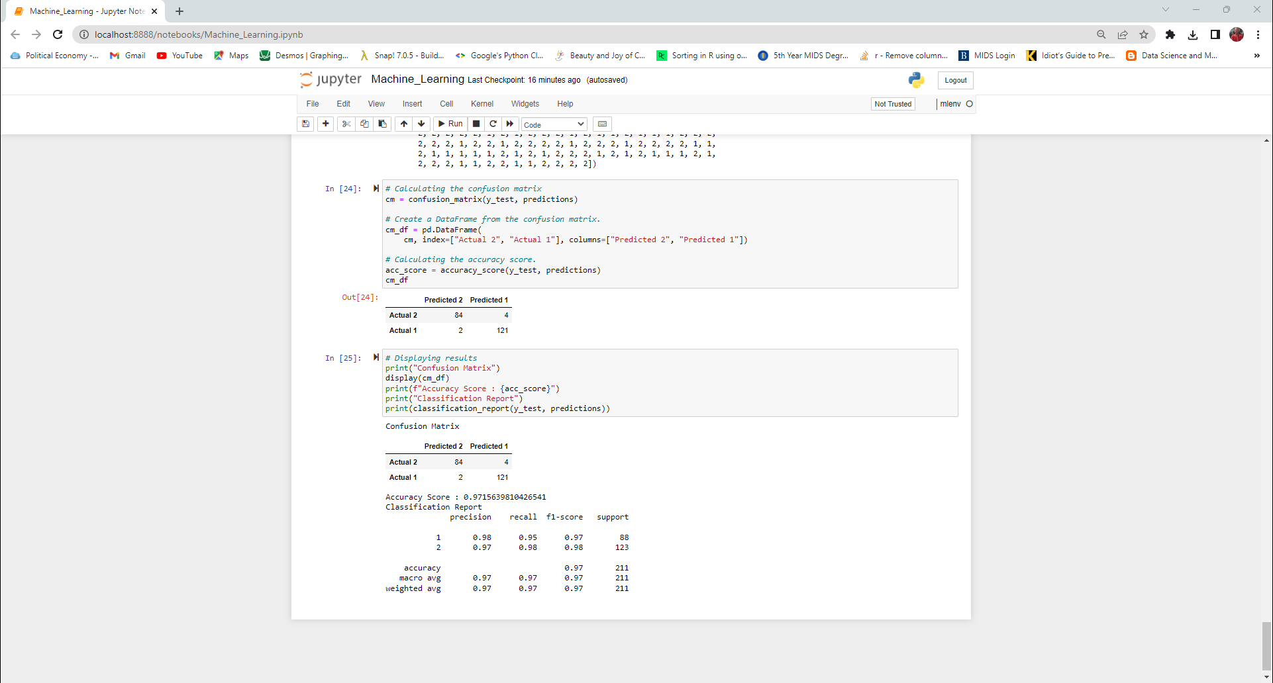
Data Analysis & Model Choice
Decision Tree model
Predictions based on material name, price, vendor, date, day of week and region
Can model predict high or low prices?
Jupyter code shows confusion matrix with final results.

Slide 18
Data Analysis & Model Choice
Decision Tree model
Predictions based on material name, price, vendor, date, day of week and region
Can model predict high or low prices?
Jupyter code shows confusion matrix and final results.

Slide 19
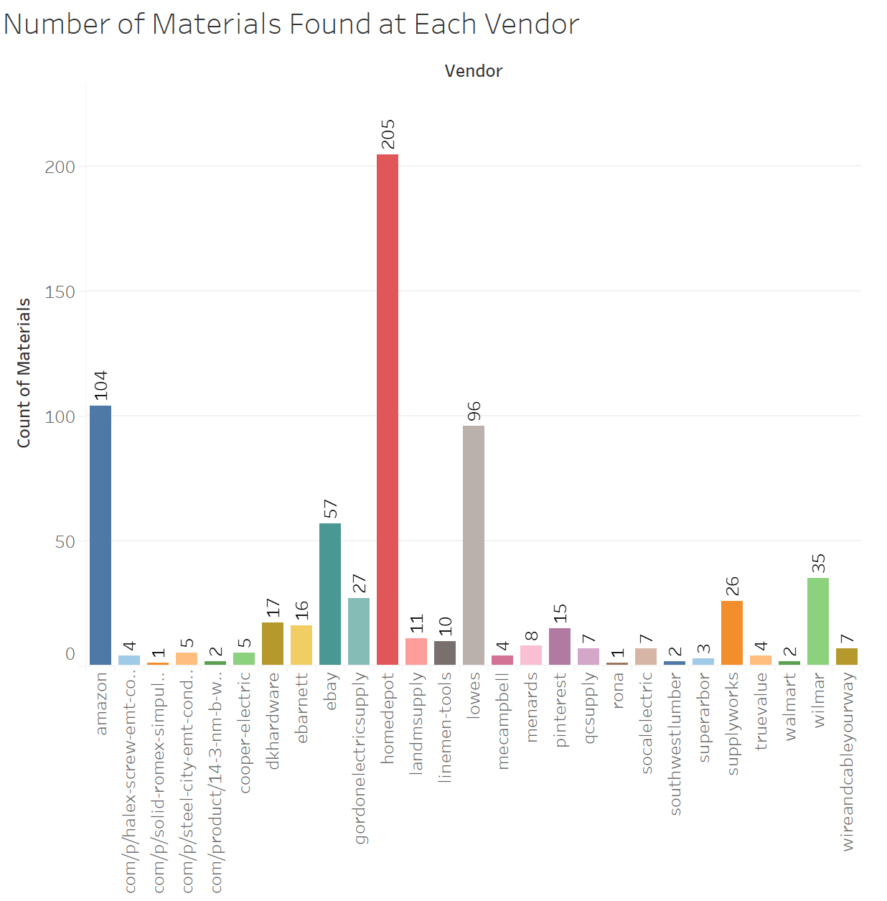
Additional Story for Dashboard
The data set includes 27 vendors and 18 materials of interest.
The bar graph shows how much material of interest each vendor can supply.
This information is important when considering who to buy from
Will want to buy from a reliable vendor who can quickly provide the material you need

Slide 20
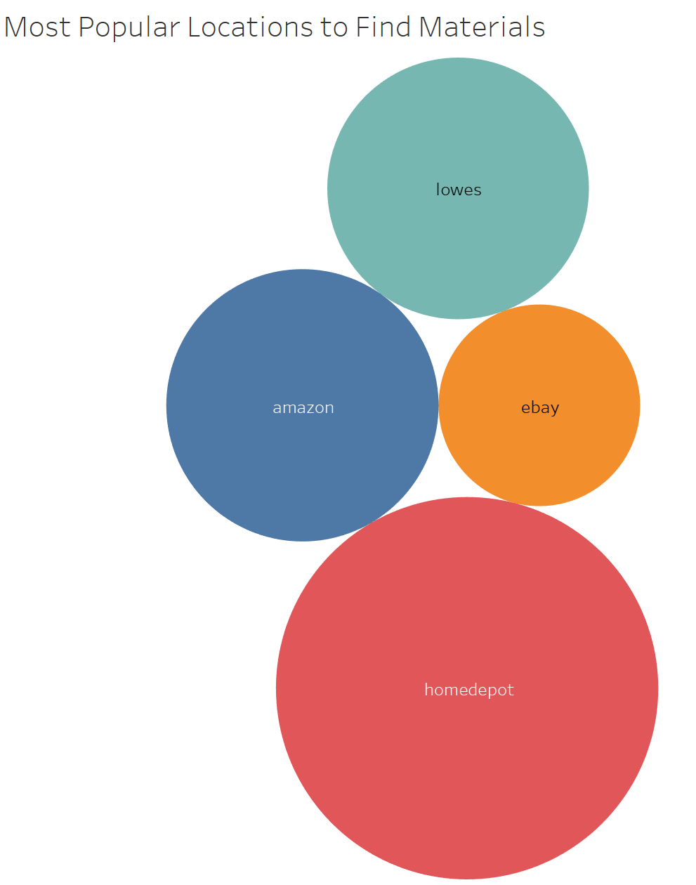
Additional Story for Dashboard
The visual shows Home Depot, Amazon, Lowe’s, and ebay are top vendors who provide majority of the materials of interest.
This is something to keep in mind since it:
Can help shorten time spent searching for material if top 3 vendors have reliable stock
Can be extra beneficial if these top vendors also provide the lowest prices

Slide 21
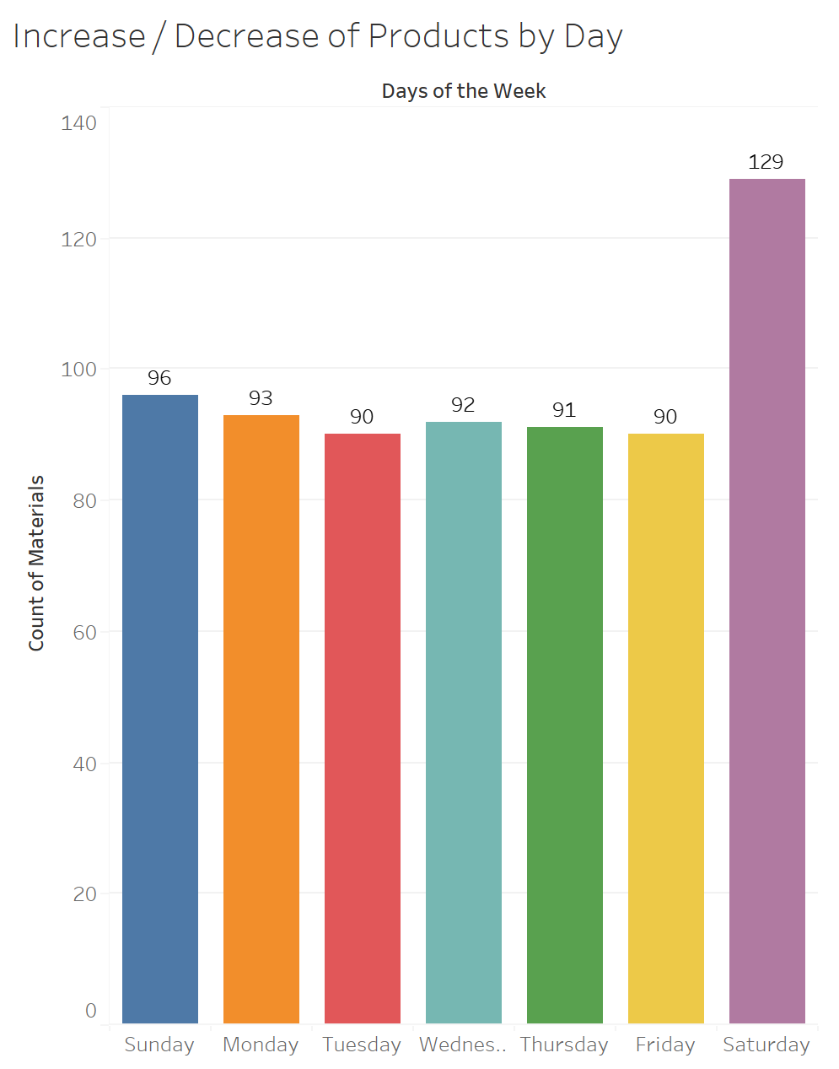
Additional Story for Dashboard
The graph shows the amount of product available per day.
Saturday is ”restocking day”, this means Saturday has an increase of available material for purchase
Purchasing material on Saturday can potentially mean all the material needed is purchased in one day vs. having to break up the days of purchase
Doing this will minimize time spent purchasing items

Slide 22
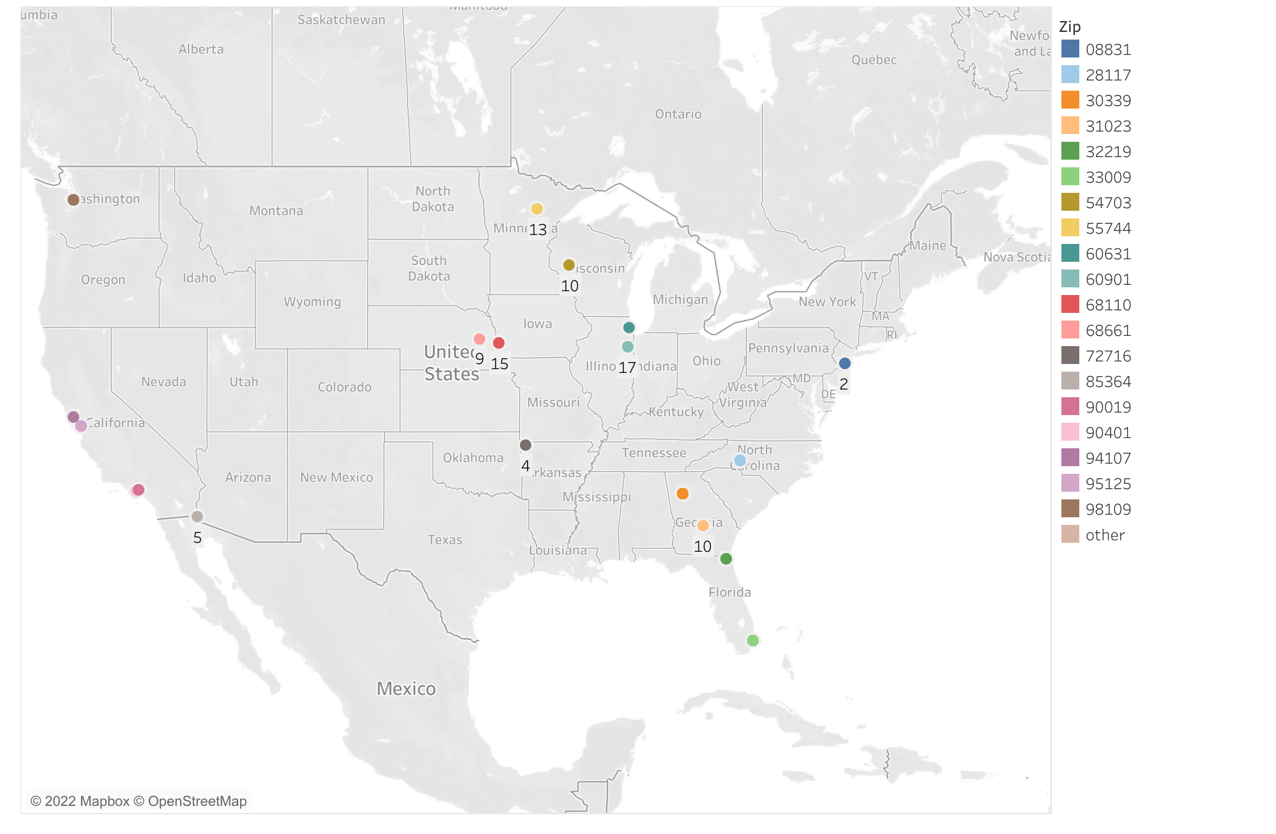
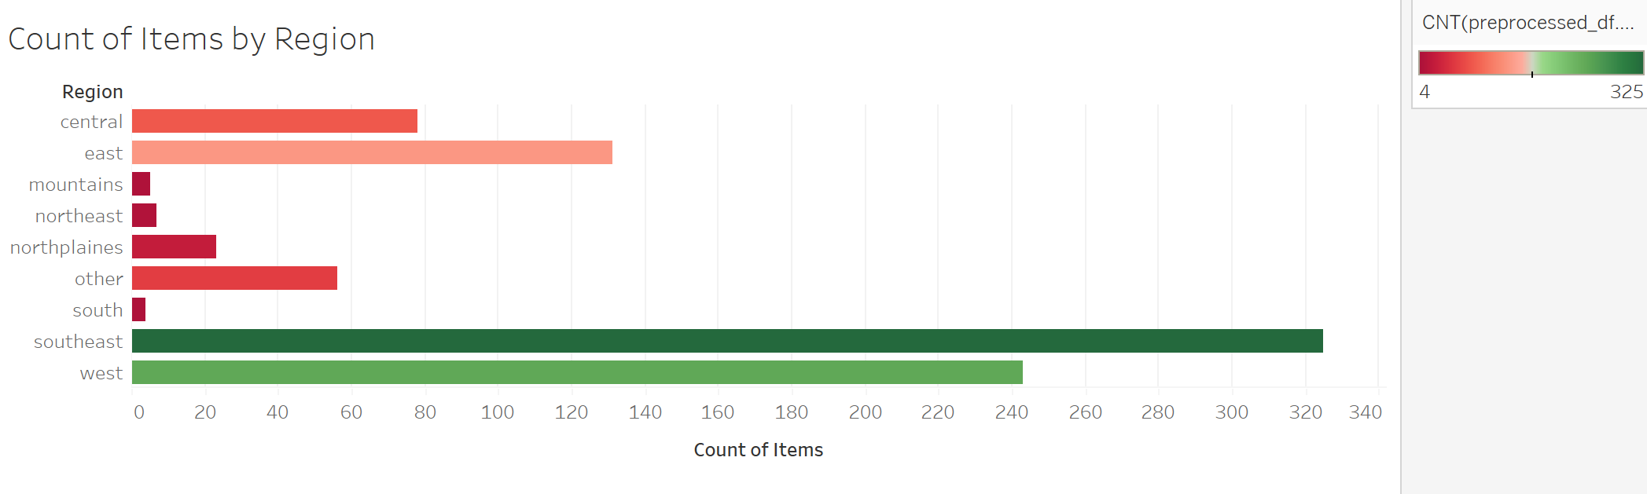
Additional Story for Dashboard
For further analysis, vendor locations have been identified and tagged on a United States map.
The bar graph below shows most of the material of interest is sourced from the southeast and west coast.

Slide 23

Additional Story for Dashboard
Tools
Reference Module 13 and Module 14 as resources and inspiration
Visuals will be created using Python and Tablaeu
The entire dashboard will be hosted on an HTML
Interactive Element
Elaborate on vendor location
Interactive map where estimators can select their:
Region of interest
Material of interest
Price range

Slide 24
Data is sourced from our own collection starting from project conception
During the beginning stages of the project, data has been collected for materials, pricing, and vendors.
This data will meet the 1000 line minimum needed for machine learning purposes.
As of 11/11/2022 we have >900 lines of data.

